Slide 1
PythonDS-08 String in Python
Dr. Naveen Kumar
Associate Professor
Amity Institute of Information Technology
Amity University Patna

Slide 2
String in python
In Python, str is a built-in immutable sequence data type used to store and manipulate textual data. It represents a sequence of Unicode characters, meaning it can natively store letters, numbers, symbols, and even emojis.
Standard Quotes (Single & Double)
These are the most common ways to create standard text strings. They behave identically.
Single-quoted strings: Enclosed in '...'. Useful if the text contains double quotes.
Double-quoted strings: Enclosed in "...". Useful if the text contains single quotes (like apostrophes).

Slide 3
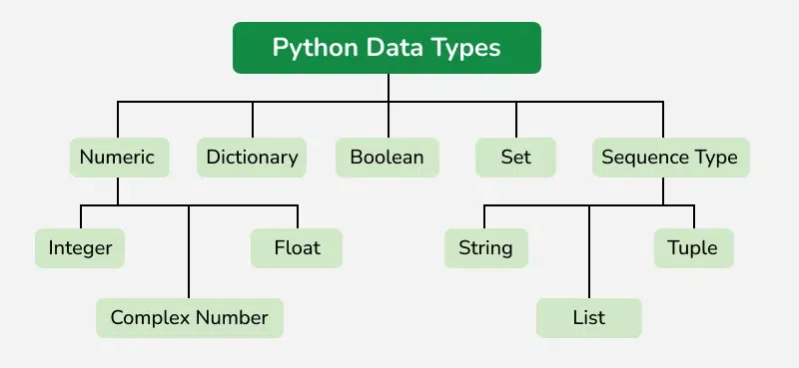

Slide 4
1. Creating Strings
Python provides several syntax options to define a string literal:
# Single or Double Quotes (Standard)
single_coords = 'Hello'
double_coords = "World"
# Triple Quotes (Multi-line strings, preserves formatting/newlines)
multiline = """This is a
multi-line string."""
# Raw Strings (Prevents backslash escaping; ideal for RegEx or file paths)
raw_path = r"C:\next\folder\file.txt"

Slide 5
Multiline Strings (Triple Quotes)
Enclosed in '''...''' or """...""". They allow text to span across multiple lines while preserving all line breaks and spaces automatically. They are also frequently used as "docstrings" for code documentation.
multiline = """This is line one.
This is line two."""

Slide 6
Special Prefix Strings
You can add a lowercase or uppercase letter right before the opening quote to give the string special properties: []
F-Strings (Formatted Strings) f"...": Evaluates variables or mathematical expressions directly inside curly braces {} at runtime. []
Raw Strings r"...": Treats backslashes \ as literal characters instead of escape characters. Essential for windows file paths or regular expressions (regex).
Byte Strings b"...": Creates a bytes object rather than a regular string (str). It represents raw 8-bit bytes and is heavily used in file handling, network sockets, and data streaming.

Slide 7
name = "Alice"
print(f"Hello, {name}") # Output: Hello, Alice
print(r"C:\Users\name\new") # Output: C:\Users\name\new (ignores \n newline)
print(b"Hello") # Output: b'Hello' (Type: <class 'bytes'>)

Slide 8
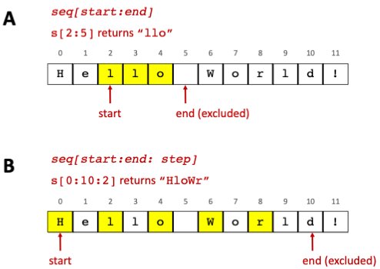

Slide 9
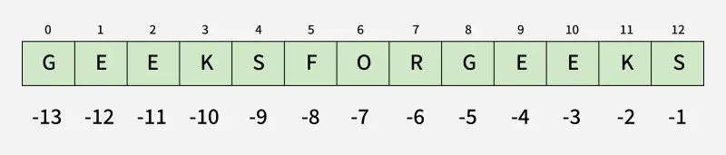
2. Core Concepts: Indexing and Slicing
Strings use zero-based indexing to access individual characters and supporting negative indices to access characters starting from the end. []
text = "Python"
# Indexing
print(text[0]) # Output: 'P'
print(text[-1]) # Output: 'n' (last character)
# Slicing syntax -> text[start:end:step]
print(text[0:2]) # Output: 'Py' (index 2 is excluded)
print(text[:4]) # Output: 'Pyth' (defaults start to 0)
print(text[::2]) # Output: 'Pto' (steps by 2 items)
print(text[::-1]) # Output: 'nohtyP' (reverses the string)

Slide 10
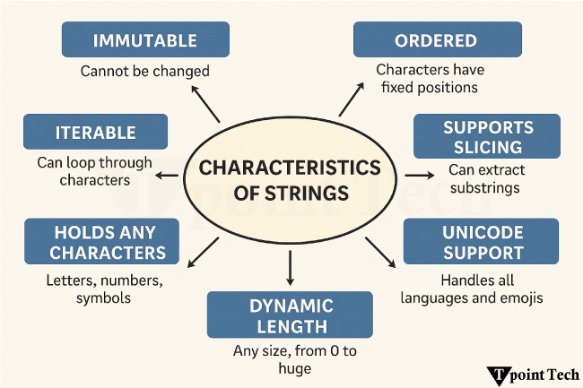

Slide 11
3. Structural Immutability
Strings are immutable, meaning their characters cannot be updated or altered in place once created. Any modification operation creates a completely new string object in memory.
msg = "Hello"
# msg[0] = "Y" --> Raises TypeError: 'str' object does not support item assignment
# Correct Approach: Reassign or construct a new string
msg = "Y" + msg[1:]
print(msg) # Output: "Yello"

Slide 12
4. Essential Built-in String Methods
Category | Method | Description | Code Example | Output
Case Changes | .upper() | Converts to uppercase | "py".upper() | "PY"
 | .lower() | Converts to lowercase | "PY".lower() | "py"
 | .capitalize() | Capitalizes the first character | "hello".capitalize() | "Hello"
Search & Test | .startswith(x) | Checks prefix string | “test.txt".startswith("test") | True
 | .endswith(x) | Checks suffix string | "test.txt".endswith(".txt") | True
 | .find(x) | Returns first match index or -1 | "apple".find("p") | 1
Clean & Alter | .strip() | Removes flanking whitespace | " hi ".strip() | "hi"
 | .replace(o, n) | Replaces old text with new | "a-b-c".replace("-", "/") | "a/b/c"
Split & Join | .split(x) | Converts string into list | "a,b,c".split(",") | ['a', 'b', 'c']
 | .join(iterable) | Merges iterable into string | "-".join(['a', 'b']) | "a-b"

Slide 13
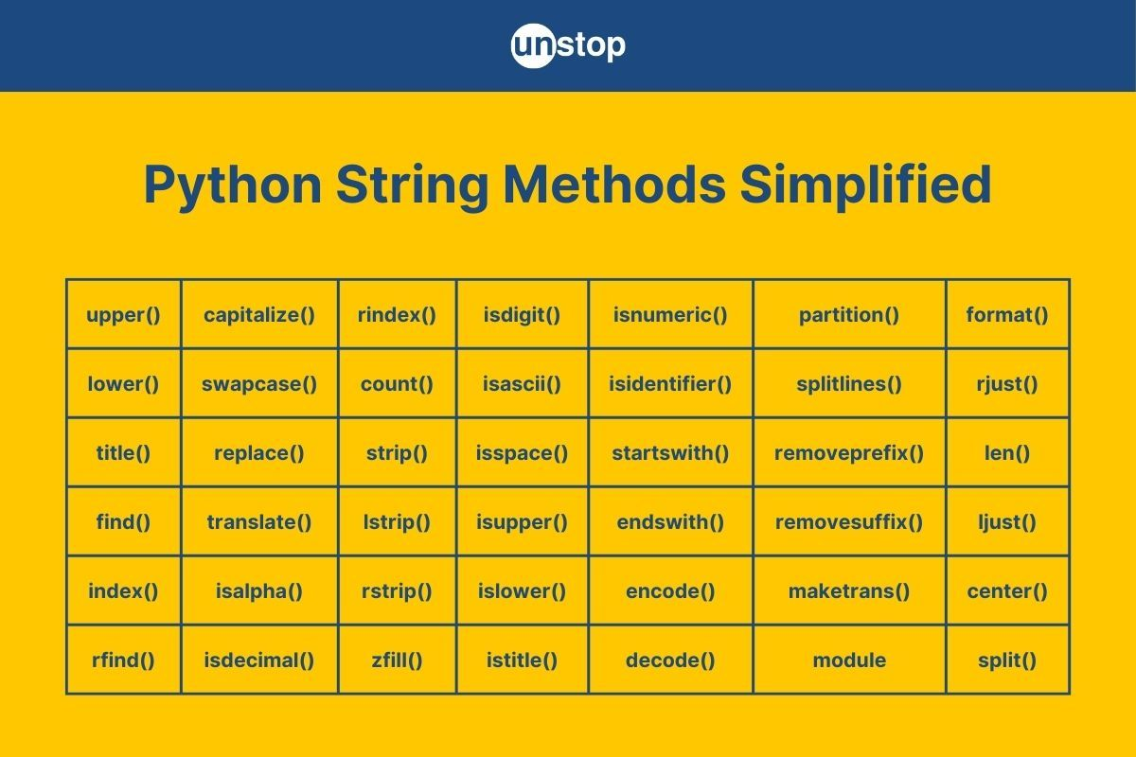

Slide 14
5. String Formatting
Modern Python applications primarily utilize Formatted String Literals (f-strings) for cleaner variable injections.
name = "Alice"
age = 30
# Modern f-string approach
print(f"Name: {name}, Age: {age}") # Output: Name: Alice, Age: 30
# Legacy .format() method approach
print("Name: {}, Age: {}".format(name, age))

Slide 15
6. The str() Global Constructor Function
The built-in global function str(object, encoding, errors) transforms non-string objects (like integers, floats, lists, or dictionary keys) into their readable text representations.
num = 456
converted = str(num) # Converts integer 456 to string "456"
print(type(converted)) # Output: <class 'str'>

